Slide 1

Sinhgad Technical Education Society’s Smt. Kashibai Navale College Of Engineering Department of Computer Engineering Academic Year: 2024-25
Topic - Real time CCTV Violence Detection
Automation System
Team : Atharva Deshmukh B1903604221
Vaishnavi Dayama B1903604282
Shubham Mane B1903604412
Shantanu Savaji B1903604500
Guided by : Prof. Priyanka Khalate

Slide 2
Agenda
Introduction
Motivation
Literature survey
Gap Analysis
Problem statement
Objectives
Social Impact
Proposed system architecture
Feasibility and Scope
Hardware and Software requirements
Advantages and Limitations
Conclusion
References

Slide 3
Introduction
All the typical real-world monitoring events cannot be cumulated in one dataset. Different typical actions may thus be distracted from regular training events and may ultimately produce false alarms.
In order for violent scene detection to be helpful in real-world surveillance applications, the identification of violence must be speedy in order to allow for prompt intervention and resolution.
We propose to incorporate subgroups into the task of VD, serving two purposes: it will increase interpretability of the outcome, by indicating where violence was detected, as well as increasing appropriateness for safety systems by enabling tracking and analysis of subgroups for VD.

Slide 4
Motivation
Initially, the rise of violent incidents and Accidents has prompted the installation of security cameras in public places, such as schools, airports, hospitals and shopping malls to ensure the security and safety of people’s life.
responding time of human operated monitoring system was extremely slow, resulting loss of person’s life and property.
identification of violent incidents has emerged as a prominent research area in computer vision over recent years due to its application and recent technological advances.
Violence detection in videos is motivated by a commitment to improving public safety and societal well-being.

Slide 5
Sr No. | Paper Name | Description | Problem Found
1. | State-of-the-art violence detection techniques in video surveillance security systems (6 April 2022). | In this systematic review, we provide a comprehensive assessment of the video violence detection problems that have been described in state-of-the-art researches. This work aims to address the problems as state-of-the-art methods in video violence detection, datasets to develop and train real-time video violence detection frameworks, discuss and identify open issues in the given problem. | Data Scarcity and Quality Real-time Processing Challenges 3. Ambiguity in Violent Behavior Definition 4. Environmental and Lighting Variations
2. | Two-stage complex action recognition framework for real-time surveillance automatic violence detection (19 September 2023). | This paper presents a novel approach to automatic violence detection in community-based surveillance. It suggests that violence is a complex action that can be classified into more identifiable actions, which can be easily recognized by human action recognition algorithms. The framework uses a two-stage architecture to detect simple actions and classifies them as complex actions. The results show that the framework achieves 21 FPS operation speeds for real-time operations and 11 FPS for non-real-time operations, with median pooling accuracy reaching 83.08% and 80.50% respectively. | 1.Complexity of Action Recognition Models 2. Limited Generalization and Overfitting 3. Real-time Constraints 4. Handling of Ambiguous or Subtle Actions
3. | Real time violence and Weapon Detection System (May 2024). | This is an article about real-time violence and weapon detection . It discusses the use of deep learning to detect violent activities and weapons in video streams . The authors propose a system that uses Convolutional Neural Networks (CNN) and Bidirectional Long Short-Term Memory Networks (LSTM) to detect violence, and You Only Look Once (YOLO) to detect weapons . The system is able to accurately identify violent activities and weapons, and issue alerts for timely intervention . Some of the flaws of the study are that it was not peer reviewed, and that the authors did not report any competing interests .Let me know if you would like learn more about real-time violence and weapon detection. | 1.Dataset Bias: If the training dataset doesn't represent a diverse range of scenarios (e.g., lighting conditions, camera angles, cultural differences in violence depictions), the model might struggle to generalize to real-world situations. 2. False Positives and Negatives: Deep learning models might misinterpret actions based solely on visual cues, leading to false positives (e.g., a playful fight being mistaken for violence) or false negatives (e.g., subtle acts of aggression going undetected). 3. Lack of Peer Review: Diverse datasets with representative scenarios and accurate labeling.

Slide 6
Sr No. | Paper Name | Description | Problem Found
4. | A Visual Approach for Real-Time Detection of Violent Actions in Videos (December 2009). | This is an article which detects car accidents using CCTV cameras. It discusses the use of neural networks to identify accidents in videos. The system also sends a message to hospital if any accident is detected. Various technologies used are : Convolutional Neural Networks , Real Time Processing, Integration with Medical Alert system, Data collection and Annotation. | 1.Data Limitation as it was tested on videos from YouTube with 89% of accuracy 2.Enviornmental Factors 3.False Positives and Negatives 4.Ethical Considerations: Privacy Concerns 5.Scalibility : Computational Cost.
5. | Real Time Violence Detection and Localization Through Sub-Group Analysis (May 2024). | This is an article about real-time violence detection and localization . The proposed method recognizes and tracks multiple subgroups across frames, providing an additional layer of information in violence detection . This enables the system to not only detect violence at video-level, but also to identify the groups involved . The system offers a small performance boost on the SCFD dataset and maintains performance onRWF-2000, reaching 91.3% and 87.2% accuracy respectively, demonstrating its practical utility while performing close to state-of-the-art methods. | Dataset Limitations: The presence of noise or artifacts in the dataset can impact the model's accuracy. Evaluation Metrics: While accuracy is a common metric, it may not capture the full picture, especially in imbalanced datasets. Generalizability : The model's performance may be limited to the specific types of violence and environments present in the training data. Real-time Constraints: The computational requirements of the proposed method may make it difficult for real-time applications. Hardware Dependencies: The model's performance may be heavily dependent on specific hardware configurations.

Slide 7
Gap Analysis
Gap:
Need for alert messages to the particular Helpline departments meaning proper classification of violence
Need for immediate response & action.
SMS alerts allow for the establishment of multiple levels of escalation.
Location of the CCTV using IP addresses must be provided to Organizations
Notifying at least 2 Organizations which are nearby the detected violence
Details of the Organizations must be provided into the System so that Notifying the Right and the closest organization is achieved.

Slide 8

Problem Statement
The use of images and security cameras has largely been used to provide post-crime evidence, which is used as proof to detect the culprits and is useful for insurance companies, police, or legal proceedings.
These solutions are based on the use of security video cameras driven by artificial intelligence (AI) algorithms.
The short-term solutions and the last-minute prevention of physical assault are precisely the ones which operate in real time; and they are the subject of this review.

Slide 9
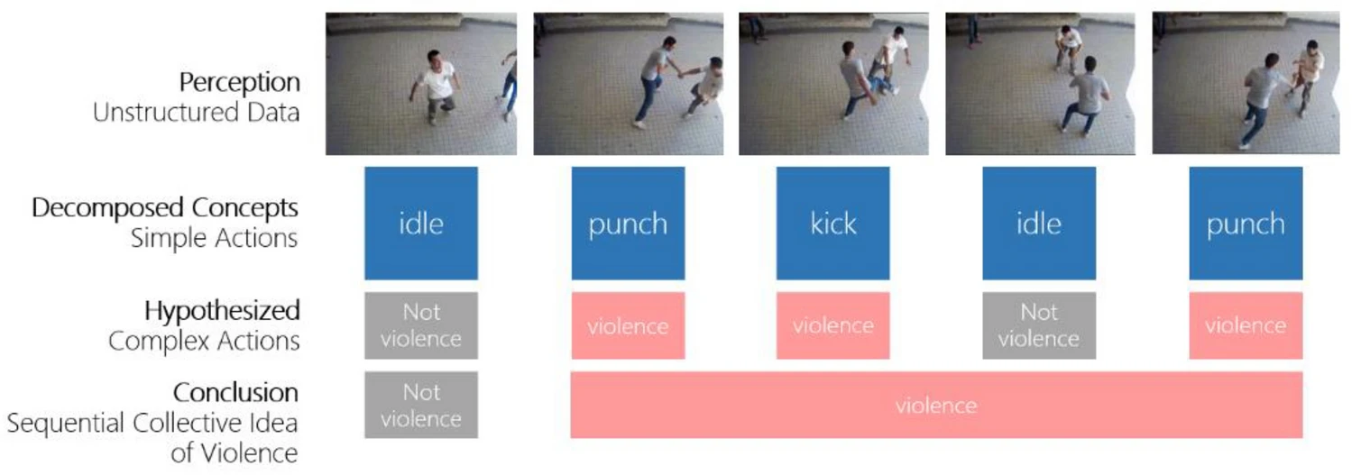
Representation of violent actions in surveillance as complex actions :

Slide 10
Objective
Immediate Threat Detection: Recognize violent activities (e.g., physical fights, assaults) in real-time from surveillance footage, public spaces, or security cameras.
Rapid Response Alerts: Instantly notify security personnel, law enforcement, or emergency services when violent behavior is detected, enabling quick intervention.
Minimize False Positives: Ensure high accuracy in distinguishing between violent and non-violent behaviors, reducing false alarms and unnecessary disruptions.
Predictive Analytics: Analyze patterns of behavior to anticipate potential violence before it escalates, providing a preventive approach.
Integration with Surveillance Systems: Seamlessly integrate with existing camera infrastructure, allowing for wide-scale deployment without the need for additional hardware.

Slide 11
Social Impact
Enhanced Public Safety: Real-time violence detection systems can significantly improve public safety by enabling quicker responses to violent incidents.
Protection of Vulnerable Populations: These systems can provide extra protection for vulnerable groups, such as children, the elderly, or individuals in high-risk environments (e.g., schools, nursing homes, or domestic violence shelters)
Reduction in Response Time: By automatically detecting violent behavior, these systems can alert security personnel or law enforcement agencies immediately, leading to quicker intervention.
Psychological Impact: The presence of such technology can create a sense of security among the public, knowing that violence can be detected and dealt with promptly.

Slide 12
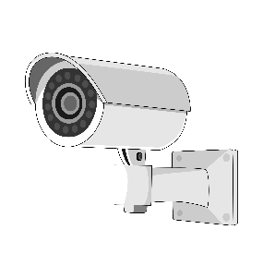
Proposed System Architecture
Continuous
Video Streaming
Convert to frames
per few seconds
Detection
of Violence
Yes
Extract the
location and time
of respective CCTV
Get Location of 2
Near By Organizations
(eg. Police Station)
No
IP addresses of all the CCTV are provided within the system
Alert Signal or Notification
Details of all Police Stations and other helpline organizations are provided
Fig name : Proposed System Architecture

Slide 13
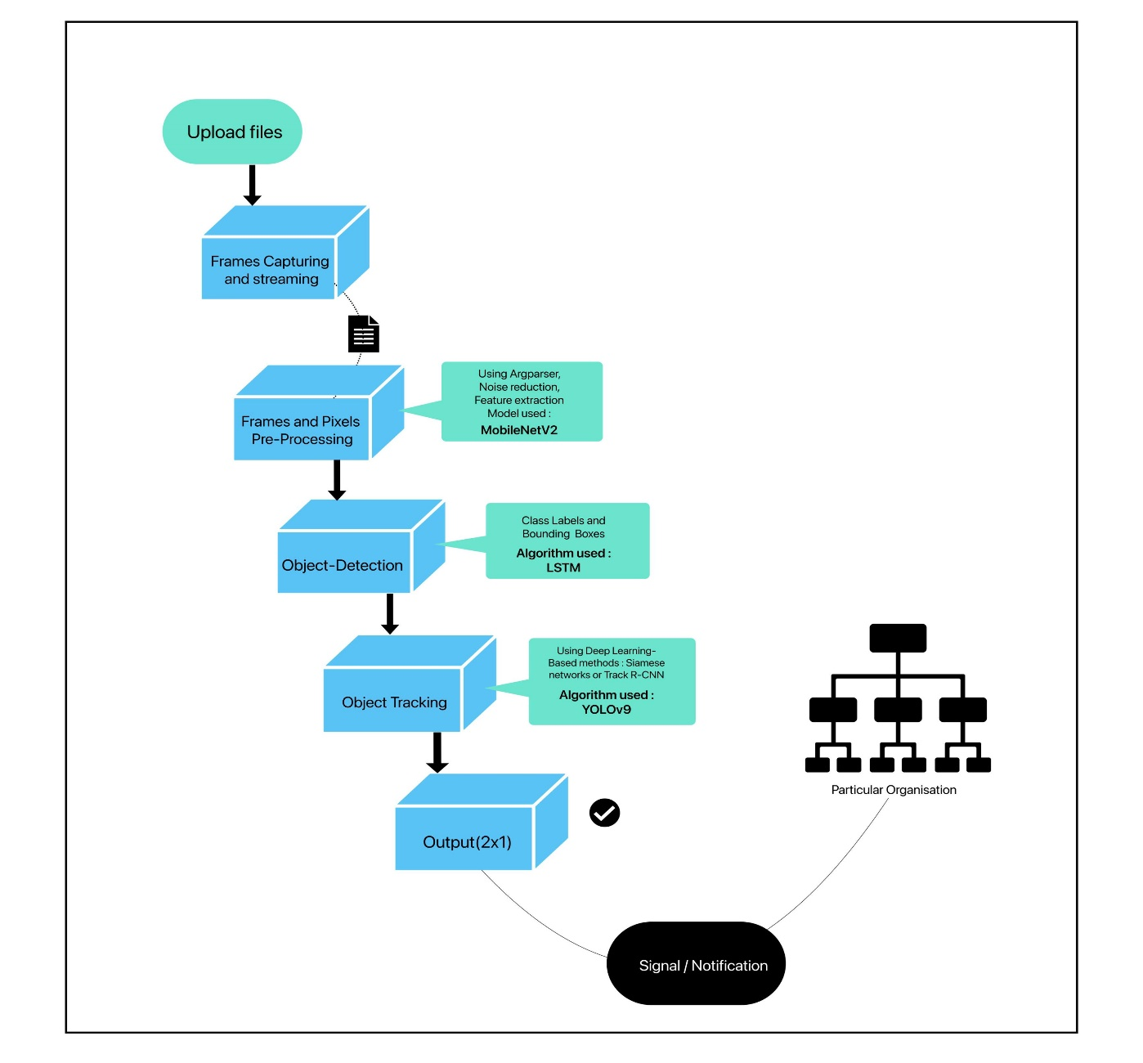
Expanding the Core logic Used to Detect the Violence
Detection
of Violence
Fig name : Core Logic

Slide 14
System architecture
Step 1 - Continuous Video Streaming: The system starts by continuously receiving video streams from multiple CCTV cameras.
Step 2 - Frame Conversion: The incoming video stream is converted into individual frames at a specific frequency, such as every few seconds. This allows for frame-by-frame analysis.
Step 3 - Violence Detection: Each frame is processed by a violence detection algorithm. This algorithm is designed to identify patterns and behaviors indicative of violent incidents, such as physical aggression or fighting.
Step 4 - Detection Decision: Based on the analysis, the system makes a decision about whether violence is detected in the current frame.
Step 5 - Positive Detection: If violence is detected then the system extracts the location and timestamp associated with the respective CCTV camera. It identifies the two nearest organizations (e.g., police stations) to the location of the incident.

Slide 15
Step 6 - Negative Detection: If no violence is detected, the system continues monitoring the video stream.
Step 7 - Alert Signal or Notification: If violence is confirmed, the system generates an alert signal or notification. This alert can be sent to various stakeholders, such as Security personnel, Law enforcement agencies, Designated authorities
Step 8 - Additional Information: The system provides details of all police stations and other relevant helpline organizations in the area. This information can be crucial for responding to the incident effectively.
Overall, the system operates as follows:
It continuously monitors CCTV footage.
It analyzes frames for signs of violence.
Upon detecting violence, it triggers an alert and provides relevant information.
This system aims to automate the detection and response to violent incidents captured on
CCTV cameras, potentially saving time and improving response efficiency.

Slide 16
SDLC Model
Agile Model :
Frequent Iterations: In this violence detection project, the requirements (e.g., new labels, model accuracy) can evolve over time. Agile’s iterative approach allows frequent updates and refinements.
User Feedback: Agile enables regular feedback from end-users or stakeholders, helping refine the model.
Rapid Prototyping: We can quickly develop a prototype, test it with real-world images, and improve the performance.
Use Case: This model is ideal as:
The project involves ongoing updates or feature additions (e.g., detecting new types of violence or integrating with different systems).
Stakeholders expect frequent deliverables.

Slide 17
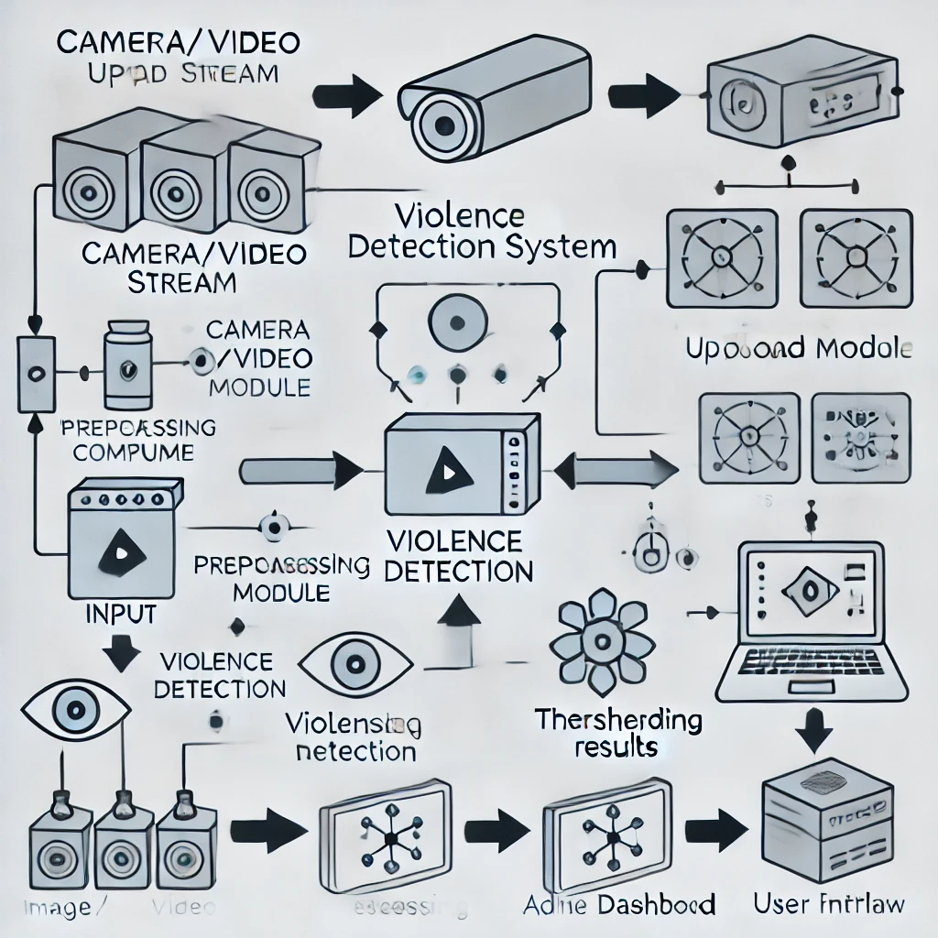
Component diagram:

Slide 18
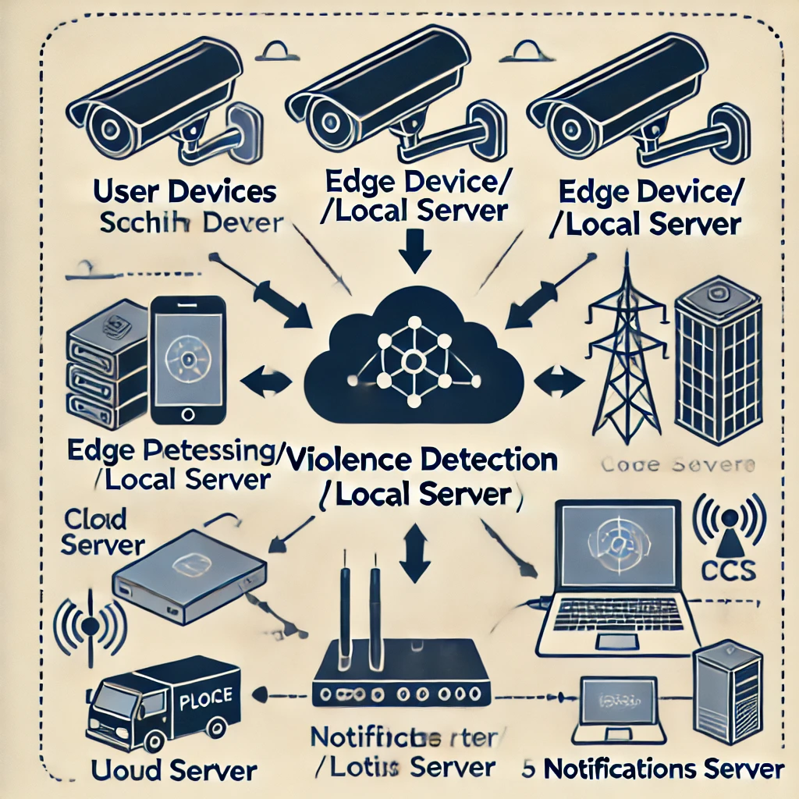
Deployment diagram:

Slide 19
Feasibility & Scope
Motion-based detection methods: Techniques that rely on analyzing movement patterns in video frames to identify violent actions.
Deep learning-based approaches: Methods leveraging neural networks to automatically learn features from large datasets.
Real-world applications and datasets: Practical implementations of violence detection systems in real-world settings and the use of benchmark datasets for standardized testing.
Hybrid models: Approaches that combine different techniques to enhance the robustness and accuracy of violence detection.

Slide 20
Hardware Requirements
Laptop with System: Intel I7 or above.
RAM: 8GB or above
GPU: NVIDIA
Mouse: Two or Three Button Mouse
Monitor: LED Monitor
CCTV Cameras:
Resolution: High-definition (HD) cameras (1080p or higher) for clear images.
2. Frame Rate: At least 30 frames per second (FPS) to capture smooth motion.
3. Field of View: Wide-angle lenses to cover large areas, if necessary.
4. Night Vision: Infrared or low-light cameras if surveillance is required in low-light conditions.
5. Weather Resistance: For outdoor cameras, they should be weatherproof (IP66/IP67).

Slide 21
Software Requirements
Operating system:
Edge Devices: Windows, Linux (Ubuntu, CentOS).
Servers: Linux (preferred for scalability and performance).
Violence Detection Software:
Pre-trained AI Models: Convolutional Neural Networks (CNNs), Long Short-Term Memory (LSTM) networks, or hybrid models trained specifically for violence detection.
Frameworks: TensorFlow, PyTorch for custom model training and inference.
Middleware: gRPC or RESTful APIs for communication between cameras and processing units.

Slide 22
Advantages
Enhanced Security: Immediate detection of violent incidents can lead to quicker response times from security personnel or law enforcement.
24/7 Automated Monitoring: Continuous surveillance without the need for human oversight reduces the risk of missed incidents.
Reduced Human Error: Minimizes the chances of oversight that can occur with manual monitoring.
Cost-Effective: Reduces the need for constant human monitoring and this turns out to be very cost effective.

Slide 23
Limitations
False Positives/Negatives: The system may incorrectly identify non-violent actions as violent or miss actual incidents, leading to trust issues.
Data Privacy Concerns: Surveillance raises ethical and legal questions about privacy rights and data protection.
High Initial Costs: Significant investment in hardware, software, and infrastructure may be required upfront.
Dependence on Quality: Requires high-quality video and proper camera placement in order for proper analysis.

Slide 24
Conclusion
Physical aggression is a serious and widespread concern in our society, affecting individuals globally and impacting nearly every aspect of life.
This influence extends not just to the immediate victims but also to their families, the broader community, and the day-to-day development of the nation, even having consequences on the economic environment.
Potential solutions have been studied, although real-time violence detection is the quickest and most immediate safeguard for victims.
This research highlights how the automation of violence detection can significantly reduce response times and improve the efficacy of security operations in high-risk environments.
Presents a significant step forward in leveraging artificial intelligence for public safety, making surveillance systems more intelligent, responsive, and reliable in detecting and addressing violent behaviors.

Slide 25
References
1. Batyrkhan Omarov, Sergazi Narynov, Zhandos Zhumanov. (2022). “State-of-the-art violence detection techniques in video surveillance security systems.”
2. Dylan Josh Domingo Lopez & Cheng-Chang Lien. (2023). “Two-stage complex action recognition framework for real-time surveillance automatic violence detection.”
3. D’Orazio, T., Leo, M., Guaragnella, C., and Distante, A. (2009). "A Visual Approach for Real-Time Detection of Violent Actions in Videos.“
4. Mohammadi, A., Namazi, S., and Salehi, M. (2021). "Violence Detection in Surveillance Videos Using Deep Neural Networks and Motion Encoding.“
5. Dao, M. L., Nguyen, T. P., and Tran, D. B. (2022). "Real-time Violence Detection in Surveillance Videos Using Deep Learning."

Slide 26
6. Sudhakaran, S., and Lanz, O. (2017). "Learning to Detect Violent Videos Using Convolutional Long Short-Term Memory." 2017 IEEE International Conference on Advanced Video and Signal Based Surveillance (AVSS), 1-6. doi:10.1109/AVSS.2017.8078503.
7. Jain, A., and Khandelwal, S. (2018). "Violence Detection in Surveillance Videos Using CNN-RNN." 2018 IEEE Symposium on Colossal Data Analysis and Networking (CDAN), 1-5. doi:10.1109/CDAN.2018.8471805.
8. Hassner, T., Itcher, Y., and Kliper-Gross, O. (2012). "Violent Flows: Real-Time Detection of Violence in Crowded Scenes." 2012 IEEE Conference on Computer Vision and Pattern Recognition Workshops (CVPRW), 1-6. doi:10.1109/CVPRW.2012.6239238.
9. Ullah, I., Ullah, A., Khan, A., et al. (2021). "Violence Detection in Videos Using CNN and LSTM: A Hybrid Approach." Electronics, 10(10), 1160. doi:10.3390/electronics10101160.
10. Dao, M. L., Nguyen, T. P., and Tran, D. B. (2022). "Real-time Violence Detection in Surveillance Videos Using Deep Learning." Journal of Information and Telecommunication, 6(1), 100-118. doi:10.1080/24751839.2020.1853478.
11. Ross, B., Lin, Z., and Zhang, C. (2019). "Violence Detection in Real-Time Surveillance Videos Using Temporal Convolutional Networks." Proceedings of the IEEE/CVF International Conference on Computer Vision Workshops, 0-7. doi:10.1109/ICCVW.2019.00260.

Slide 27
12. Ramachandran, K., and Pandey, K. (2021). "Real-Time Suspicious Activity Detection Using Deep Neural Networks in Surveillance Videos." Pattern Recognition Letters, 143, 1-8. doi:10.1016/j.patrec.2020.12.019.
13. Halder, B., Barman, S., and Ghosh, S. (2020). "Attention-Based Model for Detecting Violence in Video Surveillance Using Deep Learning." Neural Computing and Applications, 32(12), 7079-7091. doi:10.1007/s00521-019-04403-3.
14. Chowdhury, U., Basu, S., and Dey, D. (2019). "Violence Detection in Video Using 3D Convolutional Neural Networks." Journal of Visual Communication and Image Representation, 63, 102590. doi:10.1016/j.jvcir.2019.102590.
15. Le, T. T., and Do, H. T. (2022). "Multi-Scale Convolutional Neural Networks for Real-Time Violence Detection in Videos." Expert Systems with Applications, 186, 115806. doi:10.1016/j.eswa.2021.115806.
16. Singh, G., Patil, A., and Hegde, S. (2020). "A Comprehensive Review of Violence Detection in Surveillance Systems Using Deep Learning Techniques."

